Slide 1



RAIN DETECTION WITH AUTOMATIC CLOSE OF WINDOW USING RAIN SENSOR IN IOT
A MINOR PROJECT - III REPORT
Submitted by
YUVARAJ S | 927621BEC251
THARUNKUMAR R B | 927621BEC229
VASHANTH S P | 927621BEC235
SURYA S | 927621BEC313
BACHELOR OF ENGINEERING
in
DEPARTMENT OF ELECTRONICS AND COMMUNICATION ENGINEERING
M.KUMARASAMY COLLEGE OF ENGINEERING
(Autonomous)
KARUR – 639 113
OCTOBER 2023
1

Slide 2
M.KUMARASAMY COLLEGE OF ENGINEERING, KARUR
BONAFIDE CERTIFICATE
Certified that this 18ECP106L - Minor Project III report “RAIN DETECTION WITH AUTOMATIC CLOSE OF WINDOW USING RAIN
SENSOR IN IOT” is the bonafide work of “YUVARAJ S (927621BEC251), THARUNKUMAR RB (927621BEC229), VASHANTH S P (927621BEC235),
SURYA S (927621BEC313)”who carried out the project work under my supervision in the academic year 2023-2024.
SIGNATURE
Dr.A.KAVITHA, B.E., M.E., Ph.D.,
HEAD OF THE DEPARTMENT,
Professor,
Department of Electronics and Communication Engineering, M.Kumarasamy College of Engineering, Thalavapalayam,
Karur-639113.
SIGNATURE
Mr.K.SUDHAKAR., M.E
SUPERVISOR,
Assistant Professor, Department of Electronics and Communication Engineering,
M.Kumarasamy College of Engineering, Thalavapalayam,
Karur-639113.
This Minor project-IV report has been submitted for the 18ECP106L – Minor Project-IV
Review held at M. Kumarasamy College of Engineering, Karur on _ .
PROJECT COORDINATOR
2

Slide 3
INSTITUTION VISION AND MISSION
Vision
To emerge as a leader among the top institutions in the field of technical education.
Mission
M1: Produce smart technocrats with empirical knowledge who can surmount the global challenges.
M2: Create a diverse, fully -engaged, learner -centric campus environment to provide quality education to the students.
M3: Maintain mutually beneficial partnerships with our alumni, industry and professional associations
DEPARTMENT VISION, MISSION, PEO, PO AND PSO
Vision
To empower the Electronics and Communication Engineering students with
emerging technologies, responsibility.
Mission
professionalism, innovative research and social
M1: Attain the academic excellence through innovative teaching learning process, research areas & laboratories and Consultancy projects.
M2: Inculcate the students in problem solving and lifelong learning ability.
M3: Provide entrepreneurial skills and leadership qualities.
M4: Render the technical knowledge and skills of faculty members.
3

Slide 4
Program Educational Objectives
PEO1:
Core Competence: Graduates will have a successful career in academia or industry associated with Electronics and Communication Engineering
Professionalism: Graduates will provide feasible solutions for the challenging problems through comprehensive research and innovation
in the allied areas of Electronics and Communication Engineering. Lifelong Learning: Graduates will contribute to the social needs through lifelong learning, practicing professional ethics and leadership quality
PEO2:
PEO3:
Program Outcomes
PO 1: Engineering knowledge: Apply the knowledge of mathematics, science, engineering fundamentals, and an engineering specialization to the solution of complex engineering problems.
PO 2: Problem analysis: Identify, formulate, review research literature, and analyze complex engineering problems reaching substantiated conclusions using first principles of mathematics, natural sciences, and engineering sciences.
PO 3: Design/development of solutions: Design solutions for complex engineering problems and design system components or processes that meet the specified needs with appropriate consideration for the public health and safety, and the cultural, societal, and environmental considerations.
PO 4: Conduct investigations of complex problems: Use research-based knowledge and research methods including design of experiments, analysis and interpretation of data, and synthesis of the information to provide valid conclusions.
4

Slide 5
PO 5: Modern tool usage: Create, select, and apply appropriate techniques, resources, and modern engineering and IT tools including prediction and modeling to complex engineering activities with an understanding of the limitations.
PO 6: The engineer and society: Apply reasoning informed by the contextual knowledge to assess societal, health, safety, legal and cultural issues and the consequent responsibilities relevant to the professional engineering practice.
PO 7: Environment and sustainability: Understand the impact of the professional engineering solutions in societal and environmental contexts, and demonstrate the knowledge of, and need for sustainable development.
PO 8: Ethics: Apply ethical principles and commit to professional ethics and responsibilities and norms of the engineering practice.
PO 9: Individual and team work: Function effectively as an individual, and as a member or leader in diverse teams, and in multidisciplinary settings.
PO 10: Communication: Communicate effectively on complex engineering activities with the engineering community and with society at large, such as, being able to comprehend and write effective reports and design documentation, make effective presentations, and give and receive clear instructions.
PO 11: Project management and finance: Demonstrate knowledge and understanding of the engineering and management principles and apply these to one’s own work, as a member and leader in a team, to manage projects and in multidisciplinary environments.
PO 12: Life-long learning: Recognize the need for, and have the preparation and ability to engage in independent and life-long learning in the broadest context of technological change.
5

Slide 6
Program Specific Outcomes
PSO1: Applying knowledge in various areas, like Electronics, Communications, Signal processing, VLSI, Embedded systems etc., in the design and implementation of Engineering application.
PSO2: Able to solve complex problems in Electronics and Communication Engineering with analytical and managerial skills either independently or in team using latest hardware and software tools to fulfil the industrial expectations.
Abstract | Matching with POs, PSOs
Rain sensor, IOT, Arduino UNO | PO1,PO2,PO3,PO4,PO5,PO6,PO8,PO9,PO10, PO11,PO12,PSO1,PSO2
6

Slide 7
ACKNOWLEDGEMENT
Our sincere thanks to Thiru.M.Kumarasamy, Chairman and Dr.K.Ramakrishnan, Secretary of M.Kumarasamy College of Engineering for providing extraordinary infrastructure, which helped us to complete this project in time.
It is a great privilege for us to express our gratitude to Dr.B.S.Murugan., B.Tech., M.Tech., Ph.D., Principal for providing us right ambiance to carry out this project work.
We would like to thank Dr.A.Kavitha, B.E., M.E., Ph.D., Professor and Head, Department of Electronics and Communication Engineering for his unwavering moral support and constant encouragement towards the completion of this project work.
We offer our wholehearted thanks to our Project Supervisor, Mr.K.Sudhakar, M.E., Assistant Professor, Department of Electronics and Communication Engineering for his precious guidance, tremendous supervision, kind cooperation, valuable suggestions and support rendered in making our project to be successful.
7

Slide 8
ABSTRACT
A simple Rain Detection System can be easily built by interfacing an Arduino with Rain Sensor. The sensor will detect any rainfall falling on it and the Arduino board will sense it and can perform required actions. A system like this can be used in many different fields, such as agriculture and automobile fields. Rainfall detection can be used to automatically regulate the Irrigation process. Also, continuous rainfall data can help farmers use this smart system to automatically water the crop only when absolutely required. Similarly, in the automobiles sector windshield wipers can be made fully automatic by using the rain detection system. And the Home Automation Systems can also use rain detection to automatically close windows and adjust room temperature. In this tutorial, we will build a basic rain sensor using Arduino with a buzzer. You can then use this set-up to build anything you wish on top of it. Also, note that the rain sensor module is also referred to as a raindrop sensor or rain gauge sensor or rainwater sensor based on usage, but they all refer to the same sensor used in this project and they all work on the same principle.
8

Slide 9
TABLE OF CONTENTS
CHAPTER No. |  | CONTENTS | PAGE No.
 | Institution Vision and Mission |  | iii
 | Department Vision and Mission |  | iii
 | Department PEOs, POs and PSOs |  | iv
 | Abstract |  | viii
 | List of Tables |  | xi
 | List of Figures |  | xii
 | List of Abbreviations |  | xiii
1 | INTRODUCTION |  | 1
 | 1.1 | Problem Statement | 2
2 | LITERATURE REVIEW |  | 3
3 | PROJECT METHODOLOGY` |  | 4
 | 3.1 | Proposed System | 5
 | 3.2 | Components | 6
4 | WORKING METHOD |  | 15
5 | CODE USED |  | 17
6 | RESULT AND DISCUSSION |  | 20
7 | CONCLUSION |  | 21
 | REFERENCES |  | 22
9

Slide 10
LIST OF FIGURES
FIGURE No. | TITLE | PAGE No.
3.1 | Proposed Block diagram | 5
3.2 | Transistor | 6
3.3 | MQ135 Rain Sensor | 7
3.4 | Rain Sensor | 8
3.5 | Resistor | 8
3.6 | Motor Driver | 9
3.7 | Wi-Fi module | 10
3.8 | Circuit diagram for 12-volt battery | 12
3.9 | Charging test result for 12-Volt battery | 13
3.10 | Arduino IDE | 14
4.1 | Prototype of the monitoring system | 16
5.1 | Output chart | 20
10

Slide 11
LIST OF ABBREVIATIONS
ACRONYM | ABBREVIATION
IOT | Internet of Things
GSM | Global System for mobile communication
IDE | Integrated Development Environment
VDC | Volts of Direct Current
MCU | Multipoint Control Unit
11

Slide 12
CHAPTER 1
INTRODUCTION
Portable electronic devices are integral components in our daily life. Every day new products are introduced to the market that utilizes embedded computers in novel ways. In recent years, hardware such as microprocessors, microcontrollers, and FPGA chips have become much cheaper. Embedded systems are often required to provide Real-Time response. The main elements that make embedded systems unique are its reliability and ease in debugging. Some of the main devices used in embedded products are Microprocessors and Microcontrollers. Microprocessors are commonly referred to as general purpose processors as they simply accept the inputs, process it and give the output. In contrast, a microcontroller not only accepts the data as inputs but also manipulates it, interfaces the data with various devices, controls the data and thus finally gives the result.
Internet of Things is expected to produce high degree of human to machine communication along with machine-to-machine communication. The primary objective of this project is to reduce human work. Automation has always been a prime factor for security system. Our aim in the project is to design and implement a safety system. System that offers controllability through a hand-held mobile phone by means of IOT.

Slide 13
1.1 PROBLEM STATEMENT
Our project “Rain detection with automatic closing of window” is mainly intended to design an automatic wiper which operates automatically as soon as rain sensor gives the input. The aim is to design and develop a control system based an electronically controlled automotive rain operated motor is called RAIN DETECTION WITH AUTOMATIC CLOSING OF WINDOW.
Rain operated motor is consists of conduction sensor (Tough sensor) circuit, Control Unit, wiper motor and glass frame. The sensor is used to detect the rain or water flow.
There is any rain on the class, the sensor senses the rain or flow water and giving the control signal to the wiper motor.
The battery supplies the power to the sensor as well as rain operated motor. Wiper motor is automatically ON during the time of rainfall. The senor is fixed in the vehicle glass. The conductive (Touch) sensor is used in this project. It senses the rainfall and
giving control signal to the control unit. The control unit activates the wiper motor automatically. This operation is called Rain detection with automatic closing of window. This project can be extended using high efficiency GSM module.

Slide 14
CHAPTER 2
LITERATURE REVIEW
The Since the iot system is dedicated to specific tasks, design engineers can optimize it to reduce the size and cost of the product and increase the reliability and performance. Some embedded systems are mass-produced, benefiting from economies of scale. Physically embedded systems range from portable devices such as digital watches and MP3 players, to large stationary installations like traffic lights, factory controllers, or the systems controlling nuclear power plants. Complexity varies from low, with a single microcontroller chip, to very high with multiple units, peripherals and networks mounted inside a large chassis or enclosure.

Slide 15
CHAPTER 3
PROJECT METHODOLOGY
The aim is to design and develop a control system based an electronically controlled automotive rain operated motor is called RAIN DETECTION WITH AUTOMATIC CLOSING OF WINDOW.
Rain operated motor is consists of conduction sensor (Tough sensor) circuit, Control Unit, wiper motor and glass frame. The sensor is used to detect the rain or water
flow. There is any rain on the class, the sensor senses the rain or flow water and giving the control signal to the wiper motor.
The battery supplies the power to the sensor as well as rain operated motor. Wiper motor is automatically ON during the time of rainfall. The senor is fixed in the
vehicle glass. The conductive (Touch) sensor is used in this project. It senses the rainfall and giving control signal to the control unit. The control unit activates the wiper motor automatically. This operation is called Rain detection with automatic closing of window. This project can be extended using high efficiency GSM module.
Internet of Things is expected to produce high degree of human to machine communicationalong with machine-to-machine communication. The primary objective of this project is to reduce human work. Automation has always been a prime factor for security system. Our aim in the project is to design and implement a safety system. System that offers controllability through a hand-held mobile phone by means of IOT.

Slide 16
3.1 PROPOSED BLOCK DIAGRAM
POWER SUPPLY
NODE MCU
MOTOR DRIVER
RAIN SENSOR
MOTOR
Fig.3.1 Proposed Block Diagram

Slide 17
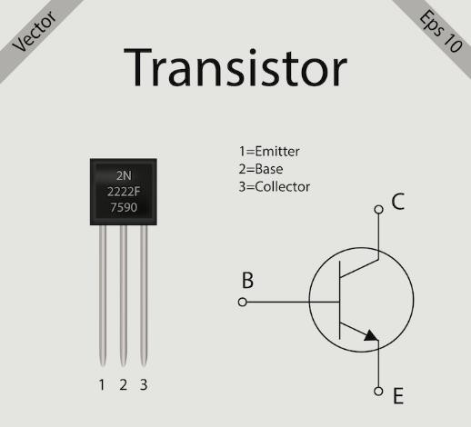
3.2 COMPONENTS TRANSISTOR
A transistor is a miniature semiconductor that regulates or controls current or voltage flow in addition amplifying and generating these electrical signals and acting as a switch/gate for them. Typically, transistors consist of three layers, or terminals, of a semiconductor material, each of which can carry a current.
Fig.3.2 Transistor
CHN 233 TRANSISTOR
The Transistors are also used for low-frequency, high-power applications, such as power-supply inverters that convert alternating current into direct current. Additionally, transistors are used in high-frequency applications, such as the oscillator circuits used to generate radio signals.

Slide 18
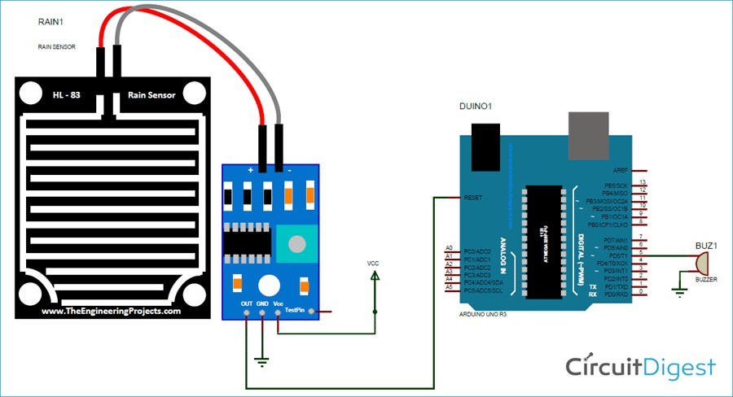
Specifications of MQ-135 RAIN Sensor
This sensor module uses good quality of double-sided material.
Anti-conductivity & oxidation with long time use.
The area of this sensor includes 5cm x 4cm and can be built with a nickel plate on the side.
The sensitivity can be adjusted by a potentiometer.
The required voltage is 5V.
The size of the small PCB is 3.2cm x 1.4cm.
It uses an LM393 comparator with wide voltage.
The output of the comparator is a clean waveform and driving capacity is above 15mA.
Fig.3.3 MQ135 Rain Sensor

Slide 19
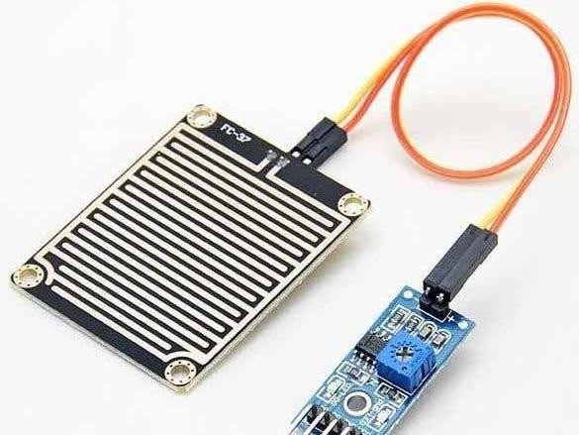
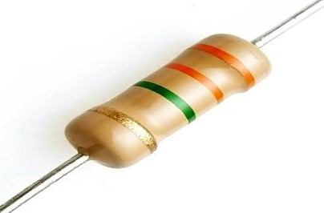
RAIN SENSOR
Raindrop sensor is basically a board on which nickel is coated in the form of lines. It works on the principal of resistance. When there is no rain drop on board. Resistance is high so we gets high voltage according to V=IR. When rain drop present it reduces the resistance because water is conductor of electricity and presence of water connects nickel lines in parallel so reduced resistance and reduced voltage drop across it.
Fig3.4. Rain Sensor
RESISTOR
A passive electrical component with two terminals that are used for either limiting or regulating the flow of electric current in electrical circuits. The main purpose of resistor is to reduce the current flow and to lower the voltage in any particular portion of the circuit.
Fig.3.5 Resistor

Slide 20
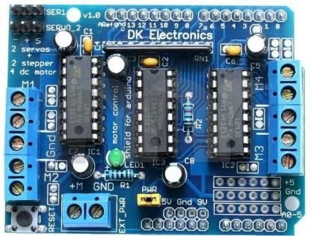
MOTOR DRIVER
A Motor driver acts as an interface between the motors and the control circuits. Motor requires high amount of current whereas the controller circuit works on low current signals. So, the function of motor drivers is to take a low-current control signal and then turn it into a higher-current signal that can drive a motor.
When voltage is applied, a motor rotates in the forward/reverse
direction according to the polarity of the voltage. The rotation speed changes in proportion to the voltage. It consists of a stator of permanent magnet, a rotor with coil, a brush, and a commutator.
Fig.3.6 Motor driver

Slide 21
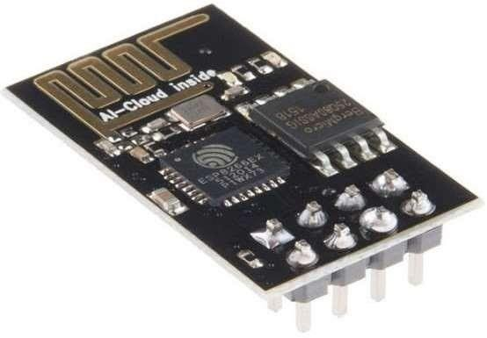
WI-FI MODULE
Wi-Fi modules or Wi-Fi microcontrollers are used to send and receive data over Wi-Fi. They can also accept commands over the Wi-Fi. Wi-Fi modules are used for communications between devices. They are most used in the field of Internet of Things.
Fig.3.7 Wi-Fi module ESP8266

Slide 22
POWER SUPPLY-12 Volt battery
12V power supplies (or 12VDC power supplies) are one of the most common power supplies in use today. In general, a 12VDC output is obtained from a 120VAC or 240VAC input using a combination of transformers, diodes, and transistors.
Switching regulated 12VDC power supplies, sometimes referred to as SMPS power supplies, switchers, or switched mode power supplies, regulate the 12VDC output voltage using a complex high frequency switching technique that employs pulse width modulation and feedback. Acopian switching regulated power supplies also employ extensive EMI filtering and shielding to attenuate both common and differential mode noise conducted to the line and load. Galvanic isolation is standard in our 12VDC switchers, affording our users input to output and output to ground isolation for maximum versatility. Acopian switching regulated power supplies are highly efficient, small and lightweight, and are available in both AC-DC single and wide-adjust output and DC-DC configurations. Our Low Profile wide adjust output switchers can be voltage or current regulated and are externally programmable.
Linear regulated 12VDC power supplies regulate the output using a dissipative regulating circuit. They are extremely stable, have very low ripple, and have no switching frequencies to produce EMI. Galvanic isolation is standard in our 12VDC linear, affording our users input to output and output to ground isolation for maximum versatility. Acopian linear regulated power supplies are available AC to DC single and wide adjust outputs.

Slide 23
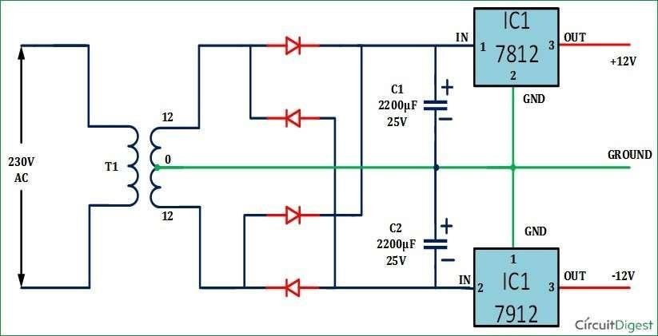
Unregulated 12VDC power supplies are basic power supplies with an AC input and an unregulated 12VDC output. The output voltage changes with the input voltage and load. These power supplies are inexpensive and extremely reliable.
Fig.3.8 Circuit diagram for 12-volt batter

Slide 24
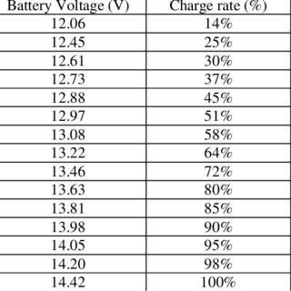
TESTING AND CHARGING
The checking of 12-Volt battery is done by voltmeter, which can be purchased cheaply from most major automotive parts stores. Check the voltage of your battery using the voltmeter to help determine your next course of action. 12.6V volts or above - Your battery is healthy and fully charged. A 12V flooded lead acid battery will have an open circuit voltage of around 12.6 volts when fully charged.
Fig.3.9 Charging test result for 12-Volt battery
ARDUINO SOFTWARE (IDE)
The Arduino Integrated Development Environment - or Arduino Software(IDE) - contains a text editor for writing code, a message area, a text console, a toolbar with buttons for common functions and a series of menus. It connects to the Arduino hardware to upload programs and communicate with them.

Slide 25
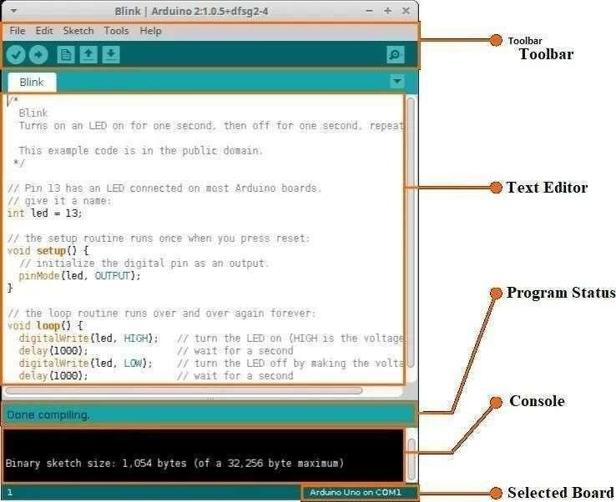
WRITING SKETCHES
Programs written using Arduino Software (IDE) are called sketches. These sketches are written in the text editor and are saved with the file extension ino. The editor has features for cutting/pasting and for searching/replacing text. The message area gives feedback while saving and exporting and displays errors.
Fig.3.10 Arduino IDE
The console displays text output by the –Arduino Software (IDE), including complete error messages and other information. The bottom right- hand corner of the window displays the configured board and serial port. The toolbar buttons allow you to verify and upload programs, create, open, and save sketches, and open the serial monitor.

Slide 26
CHAPTER 4
WORKING METHOD
The raindrop sensor measures the moisture via analog output pins and it provides a digital output when a threshold of moisture exceeds. The module is based on the LM393 op amp. It consists of an electronics module and a printed circuit board that “collects” the rain drops.
It will detect the rain and the doors or windows will be automatically closed. It indicate to the used through the app.

Slide 27
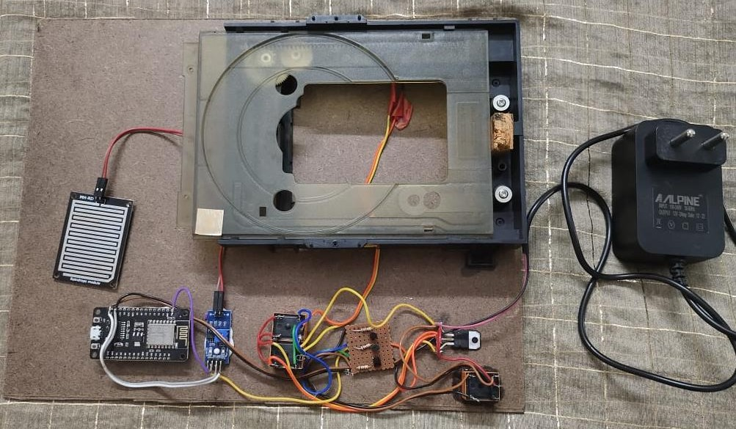
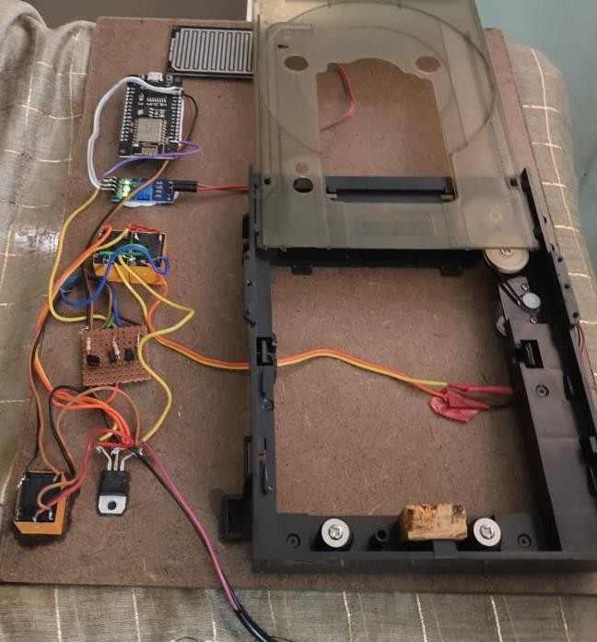
WORKING MODEL
Fig.4.1 Prototype of the monitoring system

Slide 28
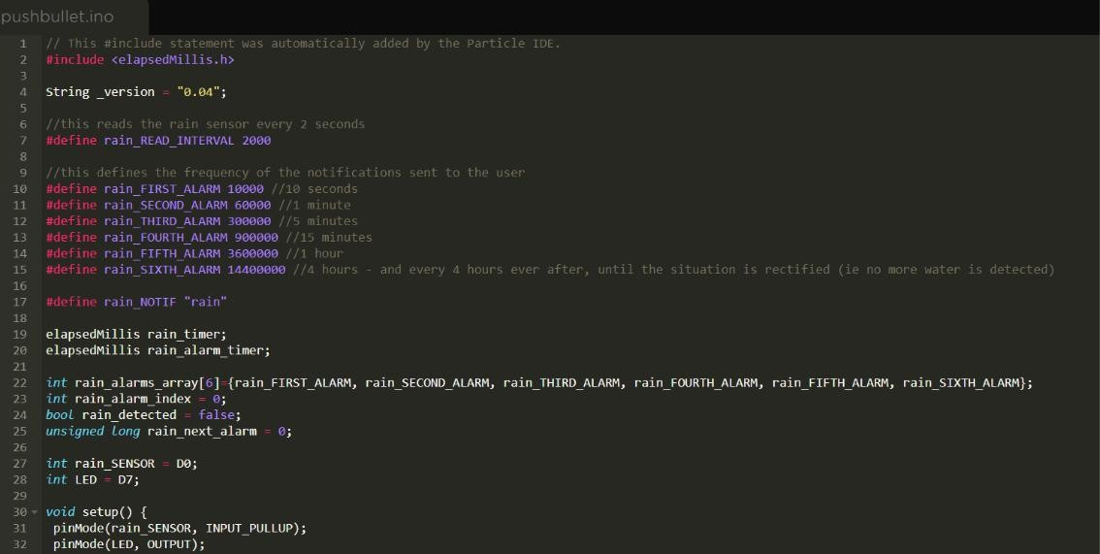
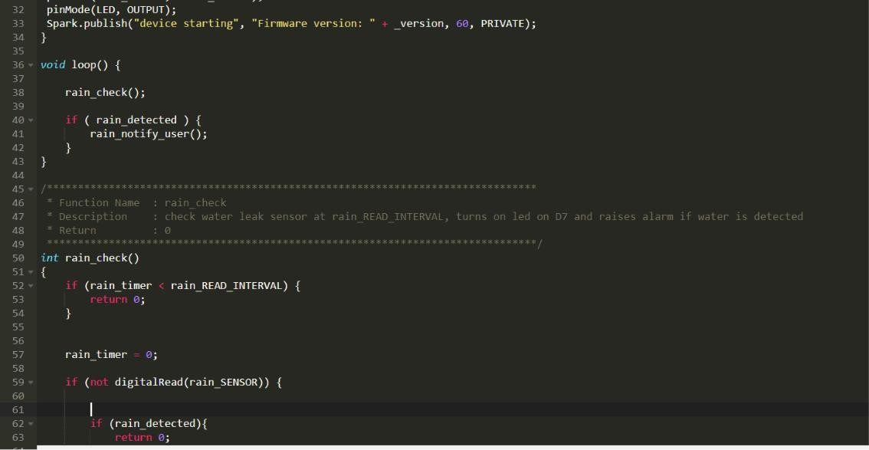
CHAPTER 5
CODE USED

Slide 29
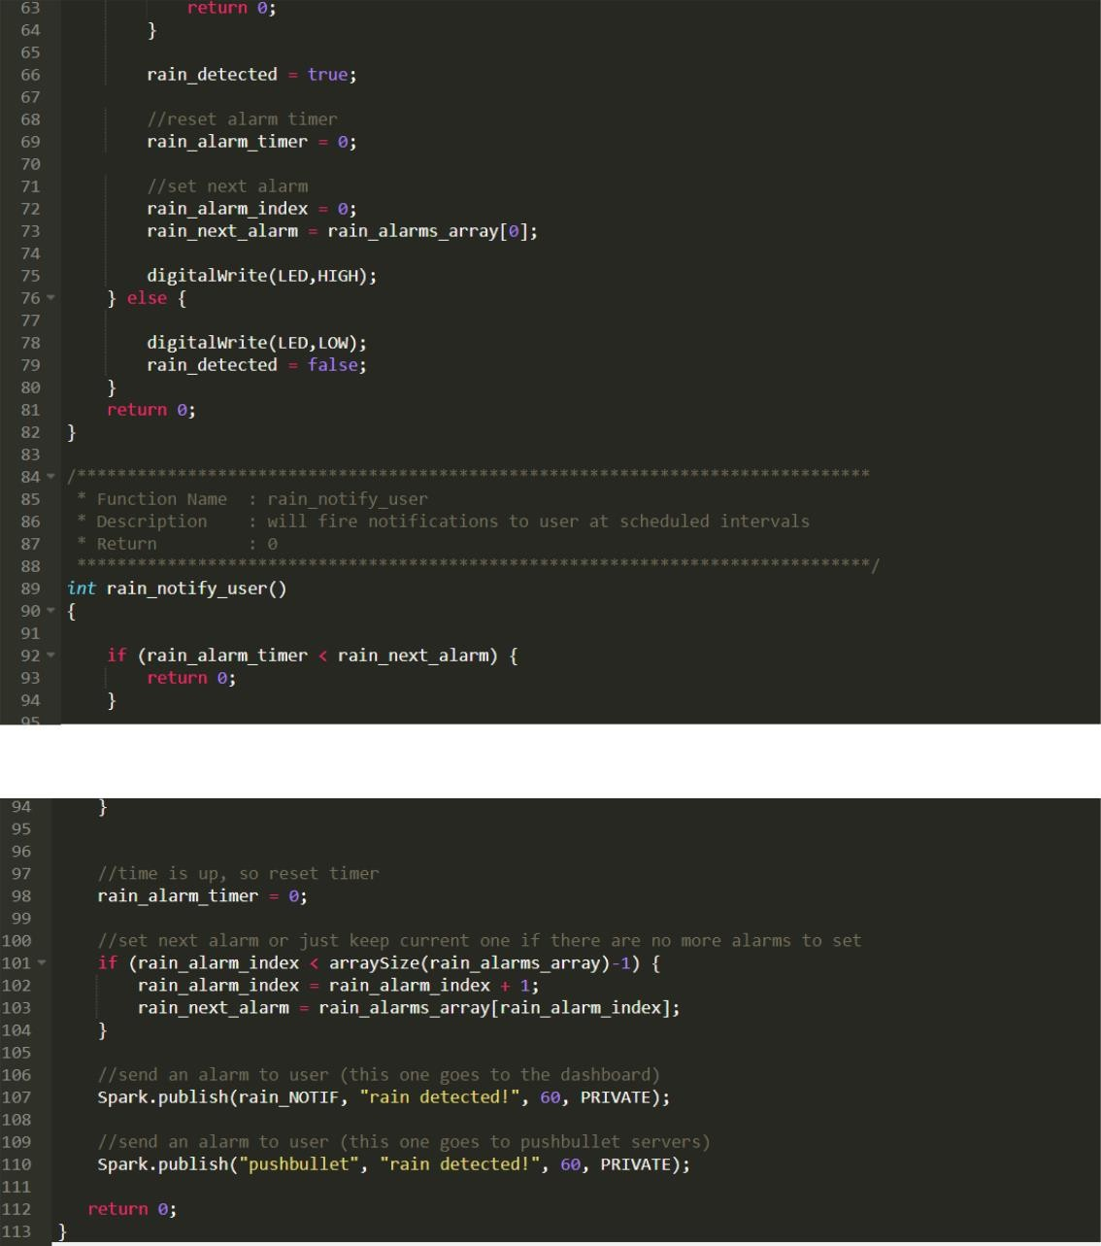

Slide 30
WORKING OPERATION
The Gas sensor present in the system is used to detect the presence of any harmful combustible gas and the temperature sensor detects the temperature of the compartment. It alerts the driver and nearby station if there is any fire produced in the compartment. These produce analog signal to the controller. The high signal produced by the input devices are processed by the controller and take necessary actions.
If the limit is exceeded, the controller provides order to the indicators. This can
also be viewed in THINGSPEAK.COM through Wi-Fi module. The output measurements can also be viewed in display module.

Slide 31
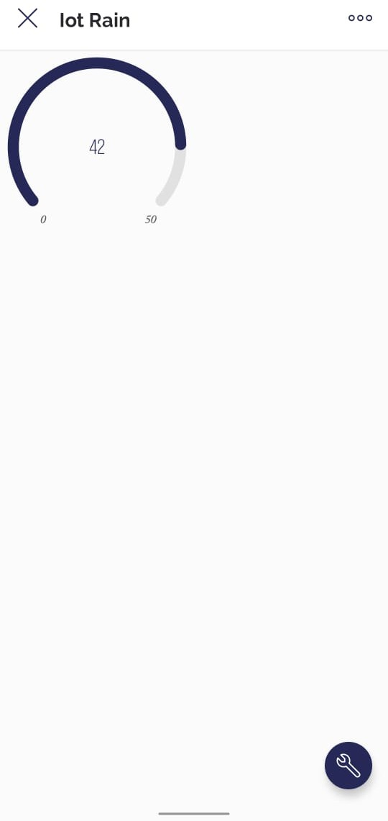
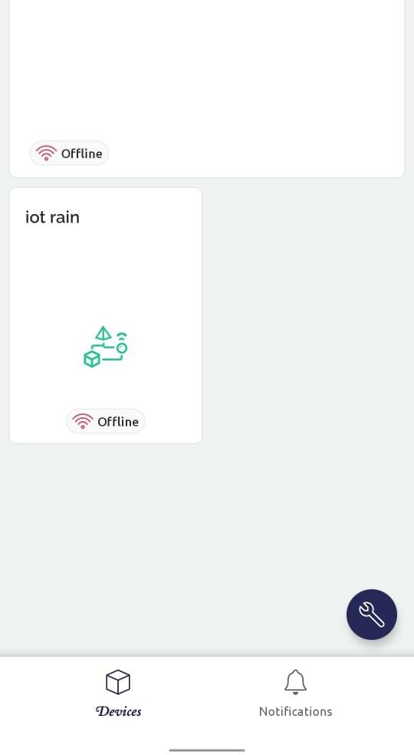
CHAPTER 6
RESULTS AND DISCUSSION
The purpose of the system is to provide a safe, reliable, simple, and cost- effective Monitoring and Security system for trains. The aim of the system is to provide a simple, secure, decisive, and cheap security system for the passengers on the train. It helps us to modify the existing safety models in the trains. The components used here are less cost and are cheaply available. The major advantage over the conventional human- based system is that it provides quick response and precise detection and control and thus helps in appropriate handling of a critical situation.
Fig.5.1 Output chart

Slide 32
CHAPTER 7
CONCLUSION
Integrating features of all the hardware components used have been developed in it. Presence of every module has been reasoned out and placed carefully, thus contributing to the best working of the unit. Secondly, using highly advanced IC’s with the help of growing technology, the project has been successfully implemented. Thus the project has been successfully designed and tested.
22

Slide 33
REFERENCES
Abhisekh Jain S, Arvind S, Balaji B.S Ram, Viyas N.P, “Onboard Dynamic Rail Track Safety Monitoring System", “International Conference on Advanced Communication Systems”, Jan2017.
G.Briundha, B.Perumal, C.Punithkumar, M.Sathyamoorth; “Automatic Railway GateControl Using Internet Of Things", “International Conference on Explorations and Innovations in Engineering & Technology”. 2016.
B.Siva Rama Krishna, D.V.S Seshendra, G.Govinda Raja, T.Sudharshanand K.Srikanth, “Railway Track Fault Detection System by Using IR Sensors and Bluetooth Technology",” Asian Journal of Applied Science and Technology”, July 2017.
Ankita Jadhav, Pallavi Bhangre , Snehal Gaikwad, Amol Deshpande " Railway Track Security System",” International Journal of Engineering Research & Technology”, March 2015.
Anap.S.D.,Ronge Prasanna L.,Bhalerao Lalit P.,Dharme Sandip P, " Railway Track Monitoring and Accident Avoidance Using Smart Sensor Network ",”International Journal of Advanced Research in Computer and Communication Engineering”, April 2016.
Mr.Prashanth.addagatla, Mr.G.Koteshwar Rao “A Modern Method for Detecting Cracks In Railway Tracks By The Efficient Utilization Of LDR And LED System"
,”International Journal of Engineering Science Invention”,2016.
Zhang Jie1, Shao Liping, “Railway Safety Monitoring Architecture Based on Internet of Things”,”Journal of Logistics, Informatics and Service Science”, 2014.
22

Slide 34
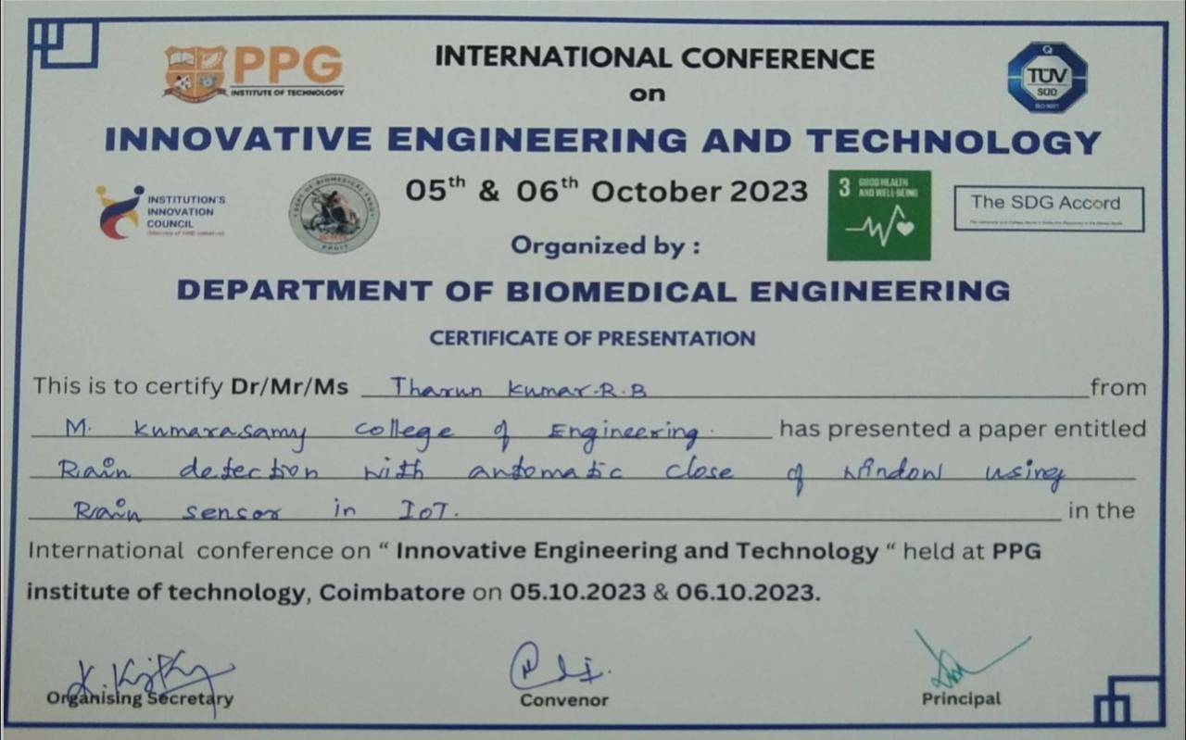

Slide 35
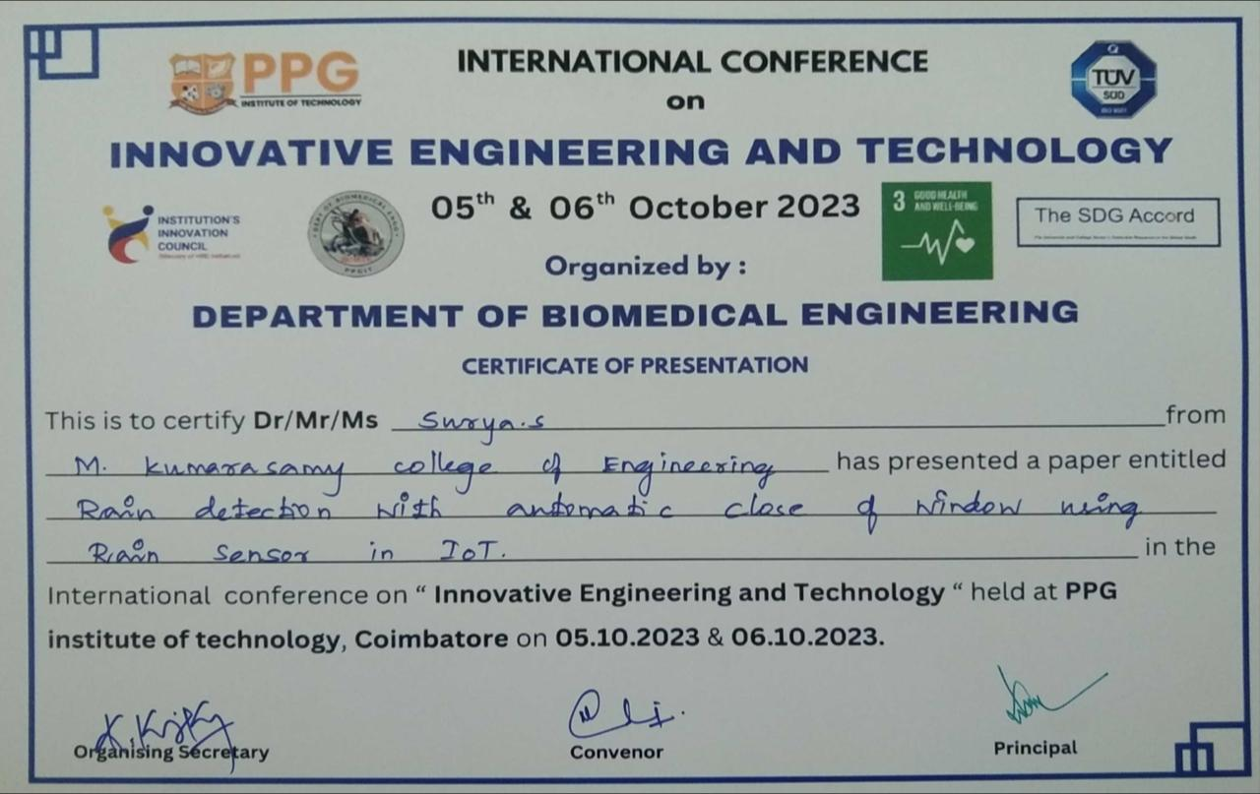

Slide 36
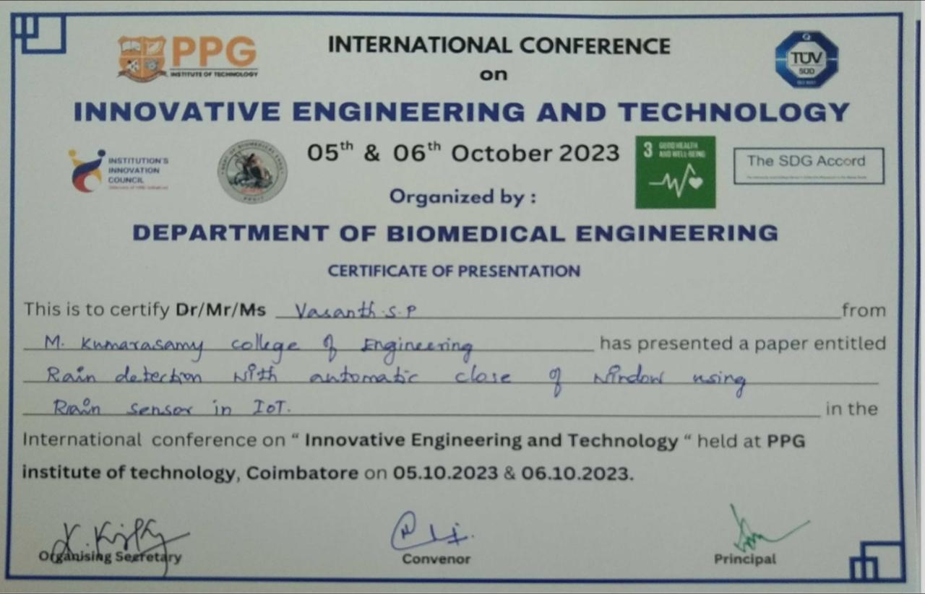

Slide 37
